Slide 1

moonworldcall@gmail.com
03155684406

Slide 2
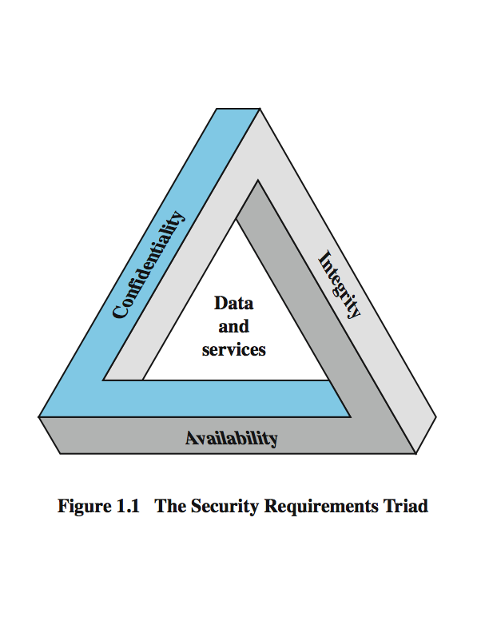
What is Network Security?
Network Security
Measures to protect data during their transmission over a network or internet
Three objectives of Network Security

Slide 3
Objectives Of Network Security
Confidentiality
Data confidentiality
Privacy
Integrity
Data integrity
System integrity
Availability

Slide 4
Security Attack
Internet Security
Network security describes in three aspects:
security attack
security service
security mechanism
Attack: Any action that compromises the security of information
Many different types of attacks
Can be generally classified as
Passive attacks
Active attacks

Slide 5
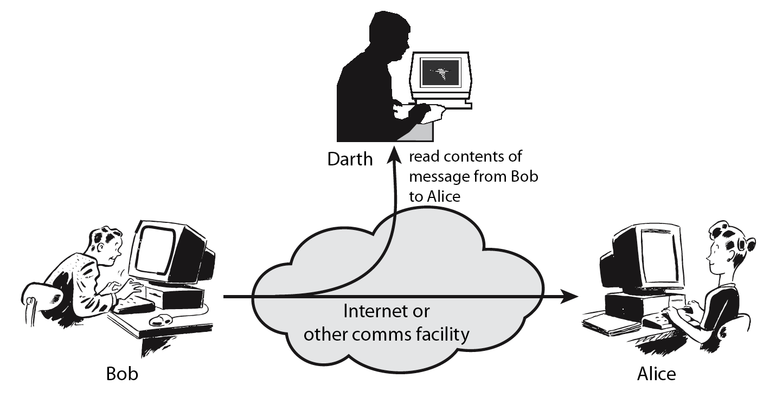
Passive Attacks (1) Release of Message Contents

Slide 6
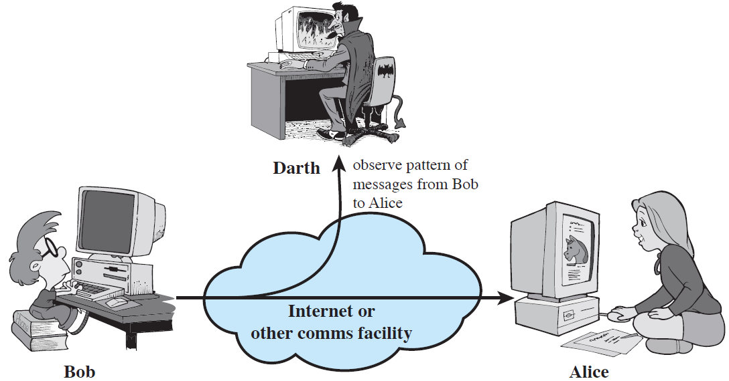
Passive Attacks (2) Traffic Analysis

Slide 7
Passive Attacks
Passive attacks do not affect system resources
Passive attacks are very difficult to detect
No alteration of the data
While most classical ciphers are vulnerable to this form of attack,
Most modern ciphers are designed to prevent this type of attack (encryption)

Slide 8
Active Attacks
Active attacks try to alter system resources or affect their operation
Modification of data, or creation of false data
Four categories
Masquerade
Replay
Modification of messages
Denial of service: preventing normal use
A specific target or entire network

Slide 9
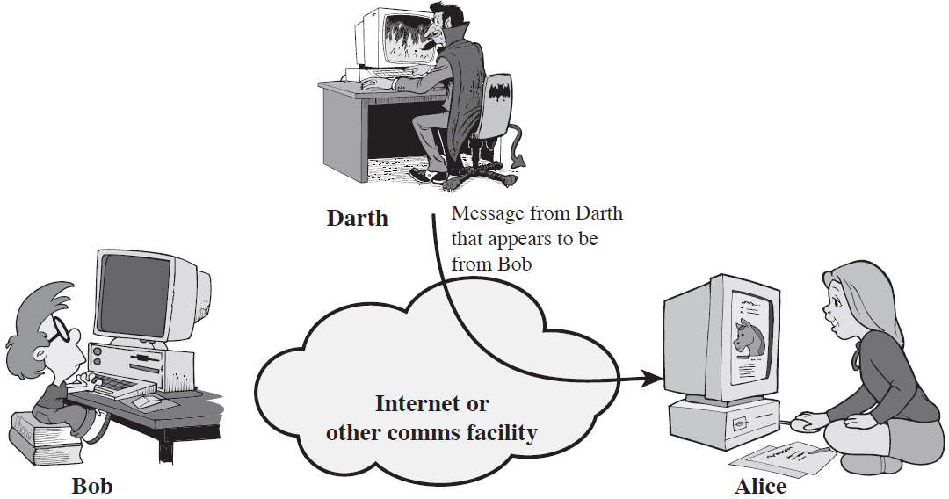
Active Attacks (1) Masquerade

Slide 10
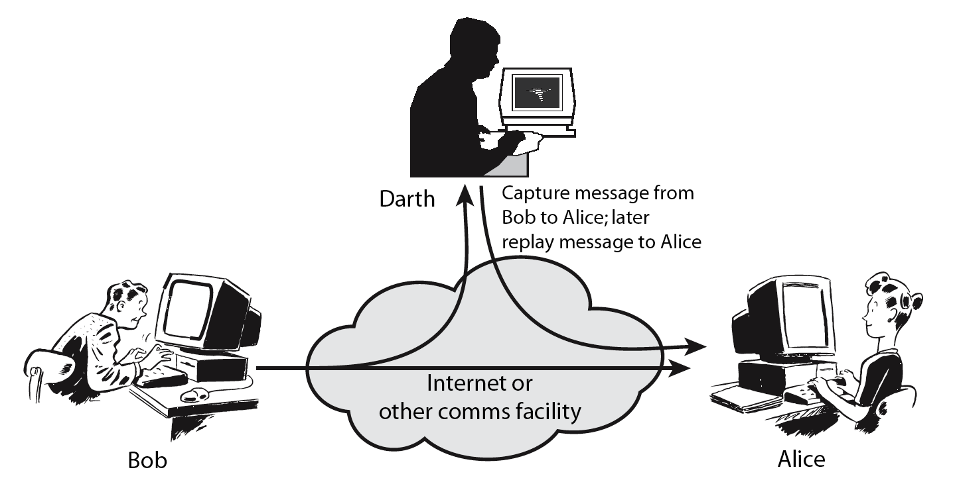
Active Attacks (2) Replay

Slide 11
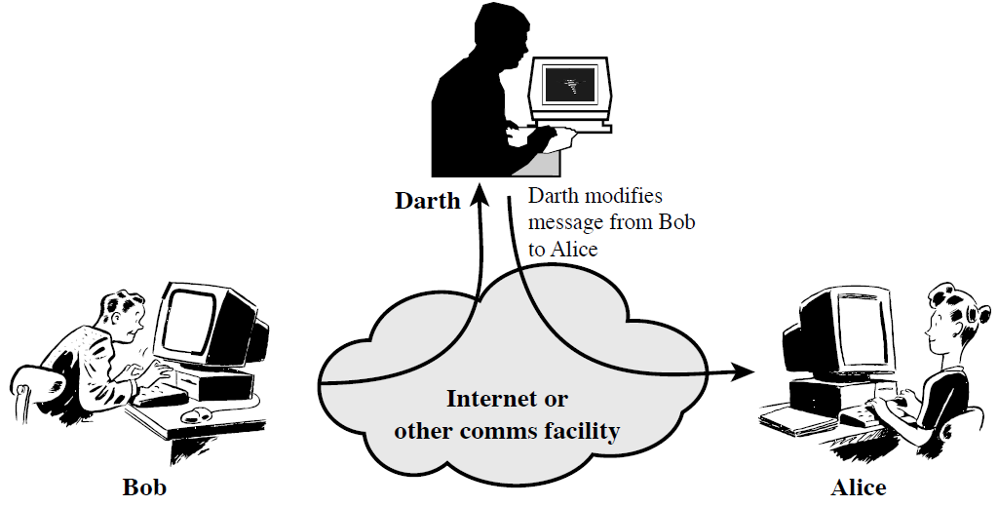
Active Attacks (3) Modification of Messages

Slide 12
Active Attacks (4) Denial of Service

Slide 13
Classical Substitution Ciphers
Earliest known substitution cipher
By Julius Caesar
First attested use in military affairs
Replaces each letter by 3rd letter on

Slide 14
Caeser Cipher
the shift cipher, Caesar's code or Caesar shift, is one of the simplest and most widely known encryption techniques
It is a type of substitution cipher in which each letter in the plaintext is replaced by a letter some fixed number of positions down the alphabet
For example, with a left shift of 3, D would be replaced by A, E would become B and so on

Slide 15
EXAMPLE
a b c d e f g h i j k l m n o p q r s t u v w x y z
D E F G H I J K L M N O P Q R S T U V W X Y Z
mathematically give each letter a number
a b c d e f g h i j k l m
0 1 2 3 4 5 6 7 8 9 10 11 12
n o p q r s t u v w x y Z
13 14 15 16 17 18 19 20 21 22 23 24 25
Meet me after the toga party (Plain Text)
PHHW PH DIWHU WKH WRJD SDUWB (Cipher Text)

Slide 16
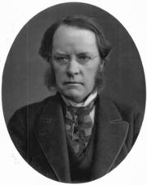
PLAYFAIR CIPHER
invented by Wheatstone on 26 March 1854,but it was promoted by Lord Playfair
LORD PLAYFAIR

Slide 17
PLAYFAIR CIPHER
It was used In World War I and World War II by British, Australians and Germans
The first published solution of the Playfair cipher was published in 1914
How to use it?

Slide 18
PLAYFAIR CIPHER
Keyword
No repeating letters
Rule for Table
Remove the letter J
Insert the desire Keyword in the table
Followed by the rest of the letters
5 * 5

Slide 19
PLAYFAIR CIPHER
K | E | Y | W | O
R | D | A | B | C
F | G | H | I | L
M | N | P | Q | S
T | U | V | X | Z

Slide 20
PLAYFAIR CIPHER
Preparing your message
Must be Split In to Pairs
Separate all duplicate letters with inserting “x”
If there is an odd letter at the end of message, Insert letter X
Rules
letters appear on the same column： replace them with the letters immediately below respectively
letters appear on the same row： replace them with the letters to their immediate right respectively
not on the same row or column (Rectangle)：
replace them with the letters on the same row respectively but at the other pair of corners of the rectangle defined by the original pair

Slide 21
PLAYFAIR CIPHER
Plain Text
SECRET MESSAGE
SE CR ET ME SX SA GE
Cipher Text
NO RO KU NK QZ PC ND

Slide 22
THANKS

